Slide 1
Comparative genomics & the X chromosome week 44 paper discussion

Slide 2
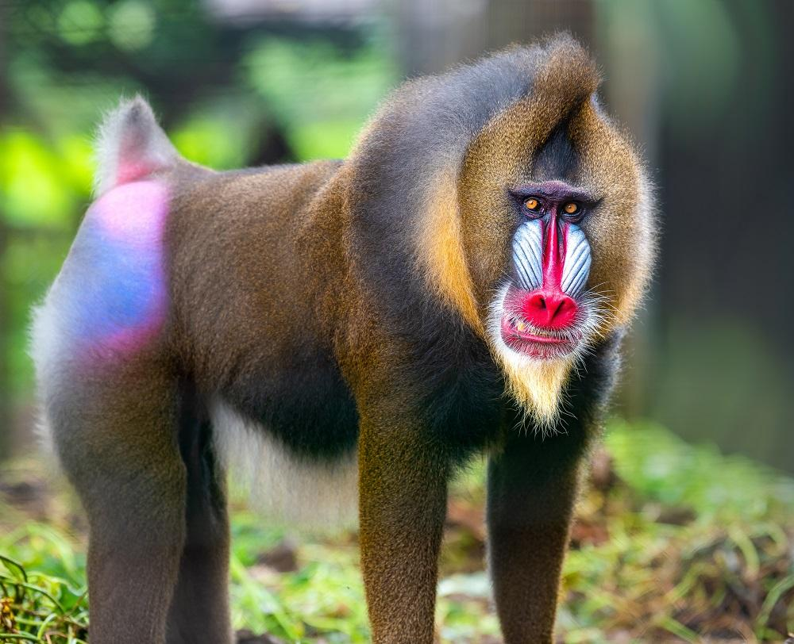
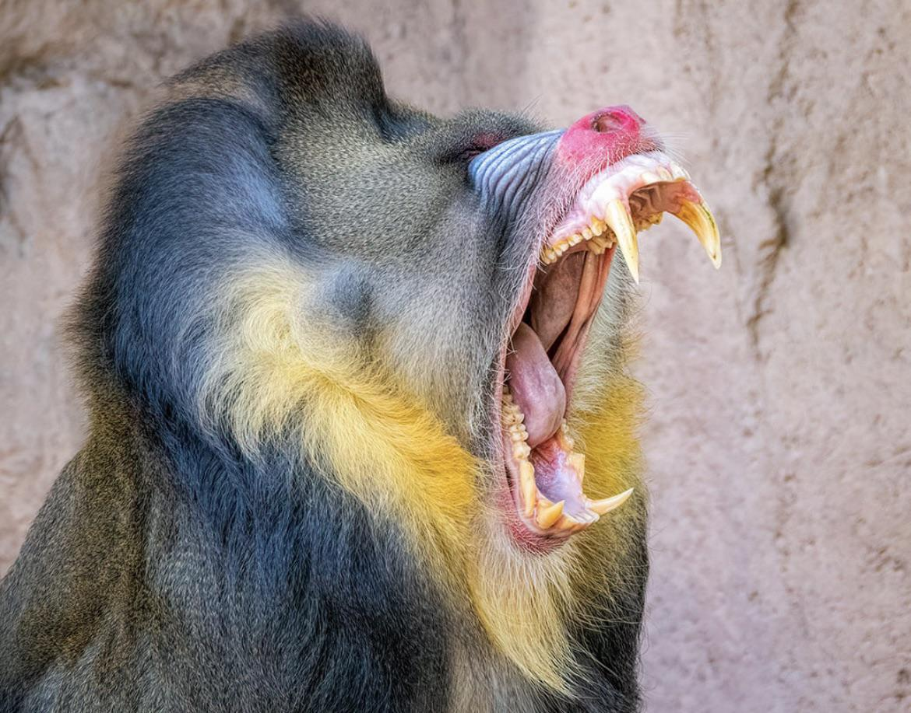
Primate of the Week
Mandrill
Mandrillus sphinx
Occurs in Africa
Largest monkey species in the world
Sexual dimorphism: Males are larger than females and more colourful
Colour indicates their testosterone level and also their status.
Females tend to prefer more colourful males.
When mandrills become excited, the colouring on their buttocks further brightens.
Notes:
https://neprimateconservancy.org/mandrill/
The vibrancy of a male indicates their testosterone levels; consequently, dominant males are the most colourful, and their colours will fade if their status decreases. Females tend to prefer more colourful males.
When mandrills become excited, the coloring on their buttocks further brightens.

Slide 3

Plan for today
1. Concepts important for today
Mammalian X chromosome decreased diversity
Introgression
Ampliconic genes
Meiotic drive
2. Paper discussion in groups
3. 3 questions in Menti (please help me)
“One Minute Paper” → link paper to lecture concepts
Active learning strategies opinion
Concepts where you need more information
Give your votes for primate of the day for Friday

Slide 4
Mammalian X chromosome decreased diversity
Wide regions with highly reduced diversity on the X
Selected sweeps
Reduced diversity is also in ancestral species, measured less ILS (incomplete lineage sorting)
There is also lack of introgression = transfer of genetic information from one species to another as a result of hybridization between them and repeated backcrossing

Slide 5
Ampliconic genes
X and Y ampliconic genes
Gene copies with very high similarity
Copy number varies between different species of primates
Most of these genes are testis specific (during Male Meiosis)
Could this be meiotic drive?
Battle of the sex chromosomes → X and Y selfishly enhance their transmission to the next generation

Slide 6
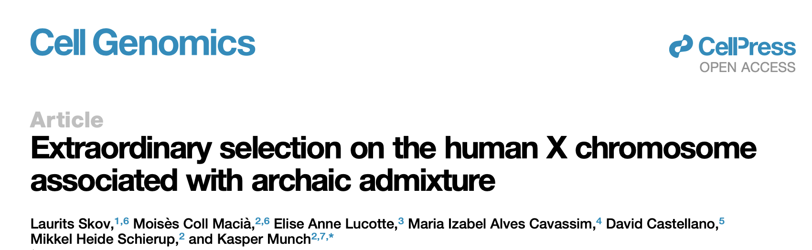
Todays paper

Slide 7
Plan for today
1. Concepts important for today
2. Paper discussion in groups
Write down your answers in statements as well
3. “One Minute Paper” at the end in Menti

Slide 8
Friday
Exercises in python!

